Slide 1
Face Detector Output & Original Image
Module 1
Skin Color Model
Dynamic Background Modeler
Module 2
RF 1
RF 2
RF 3
RF 4
RF 5
Evidence Aggregator
Face
Decision Confidence
Non Face
* RF: Random Field Model

Slide 2
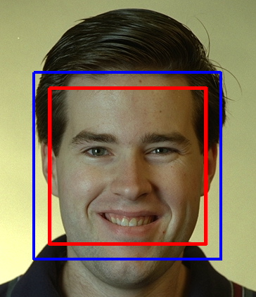
Face Detection Output
Extra-region of extraction for background model

Slide 3
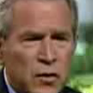




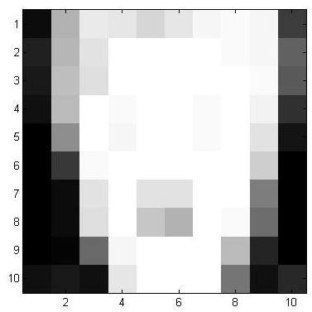
Face Detection Output
Face Detection Output
Skin Mask
Skin Mask
True Detection
False Detection
C₋₄
C₋₃
C₋₂
C₋₁
C₀
C₀
C₁
C₂
C₃
C₄
Sample for Random Field learning
R₁
R₂
R₃
R₄
R₅
R₆
R₇
R₈
R₉
R₁₀

Slide 4
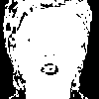
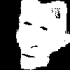
N³
N³
N¹
N¹
C₋₄
C₋₃
C₋₂
C₋₁
C₀⁻
C₀⁺
C₁
C₂
C₃
C₄
N²
N²
N⁴
N⁴
N⁵
Pose 1
Pose 2
Pose 3

Slide 5
Confidence
1
0.8
0.6
0.4
0.2
0
Log Likelihood
L_{L}
L_{U}

Slide 6
 |  | Expert 1’s opinion
 |  | Face m₁(B) | Non-Face m₁(C)
Expert 2’s Opinion | Face m₂(B) | Opinion Intersect [m₁(B) * m₂(B)] (Sum in Numerator) | Opinion Conflict [m₁(C) * m₂(B)] (Sum into K)
 | Non-face m₂(C) | Opinion Conflict [m₁(B) * m₂(C)] (Sum into K) | Opinion Intersect [m₁(C) * m₂(C)] (Sum in Numerator)

Slide 7
 | FERET | In-house
# actual face images | 14,051 | 2,597
# detections | 6,208 | 2,324
# true detections | 4,420 | 2,074
# false detections | 1,788 (28.8%) | 250 (10.7%)
 | Before Validation | After Validation
NFD | 1,788 | 208
FDR | 28.8% | 3.35%
P | 0.7120 | 0.9551
C | 0.026 | 0.281
 | Before Validation | After Validation
NFD | 250 | 2
FDR | 10.7% | 0.01%
P | 0.892 | 0.999
C | 0.691 | 0.798

